Slide 1
Forensic Analysis of Hard Drive Image
Digital Forensics Case Report: M57.BIZ Exfiltration
ABDUL HARIZ MOHD SARNUDIN (CBS24070208)
SEMESTER 5 / DCBS / CBS 1
TTO : SIR HAFIZ RAZALI

Slide 2
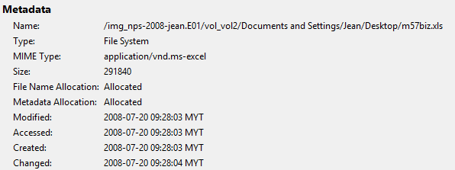
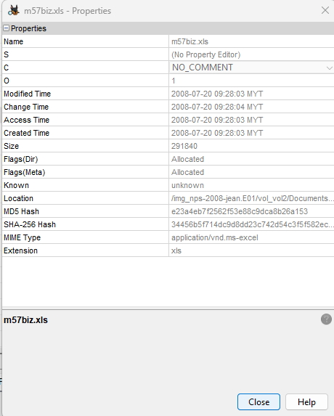
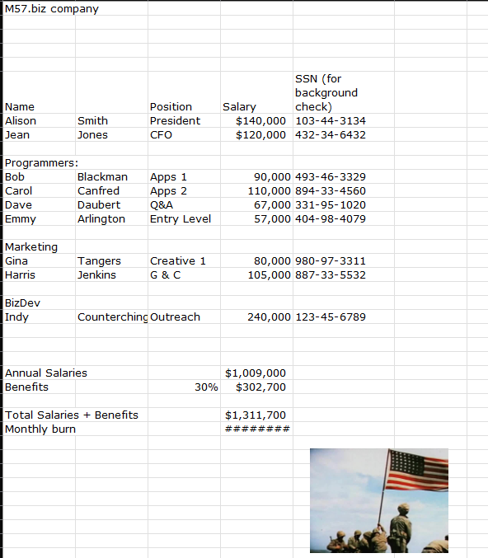
When did Jean create this spreadsheet?

Slide 3
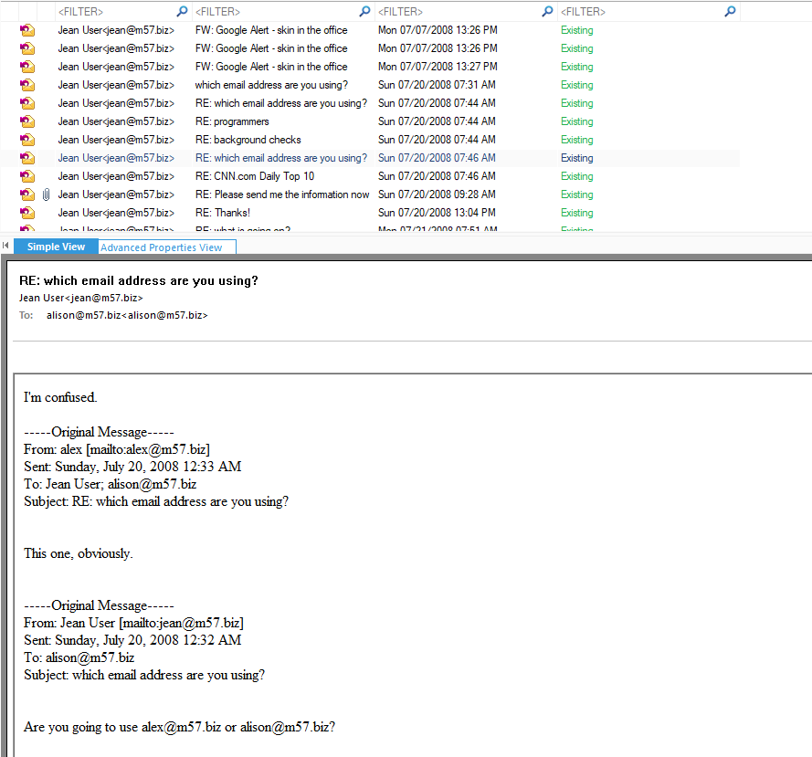
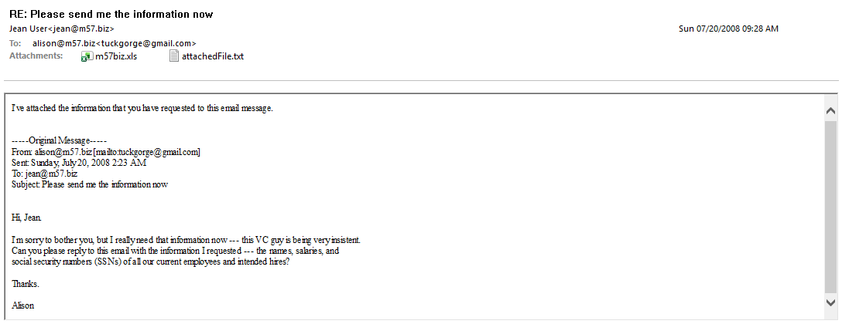
How did it get from her computer to competitor's website?

Slide 4
Who else from the company is involved?
No other employees from M57.biz were involved in orchestrating, facilitating, or assisting in the data breach. Digital forensic analysis confirms that this incident was purely an external attack executed without any internal co-conspirators or insider threat.
  Alison Smith (President): Completely innocent. Her display name was spoofed by the attacker (tuckgorge@gmail.com), and she had no role in sending or receiving the data.
  Jean User (CFO): The only employee involved. She unintentionally leaked m57biz.xls after falling for social engineering without verifying the real email address or checking with Alison in person.
  Other Staff: Forensic logs show zero evidence of insider collusion or assistance.

Slide 5


Tools Used :
Link Here
Link Here

